Slide 1



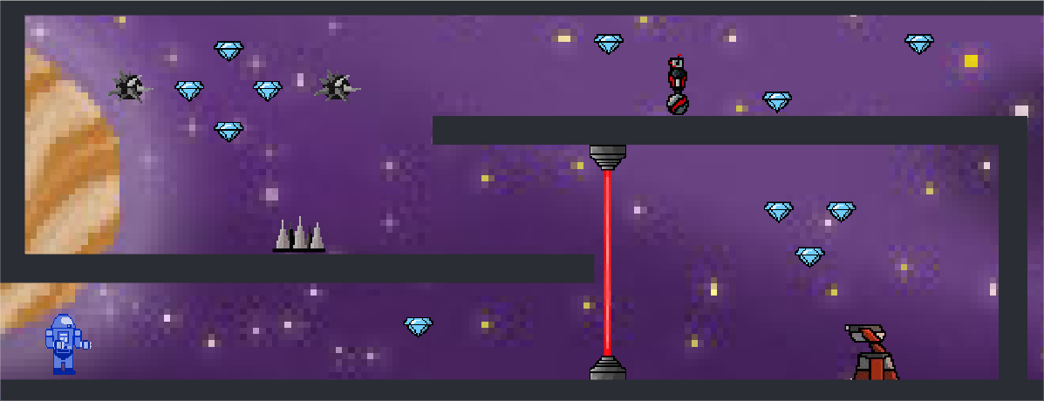
Space Runner
Nicholas Soffa – CMSI 402 – Spring 2017
Description
Motivation
Space Runner is a 2D side scrolling platforming game. The player controls a space marine, fighting to survive in never-ending corridors of enemies and traps.
The space marine can also travel back and forth between two linked versions of these randomly generated hallways.
The project goal is to develop an original spin on the genre of “infinite running” games, and provide the player with more control over interaction with the game. Having seen so many of this type of game on app stores, I wanted to produce something different.

